Slide 1
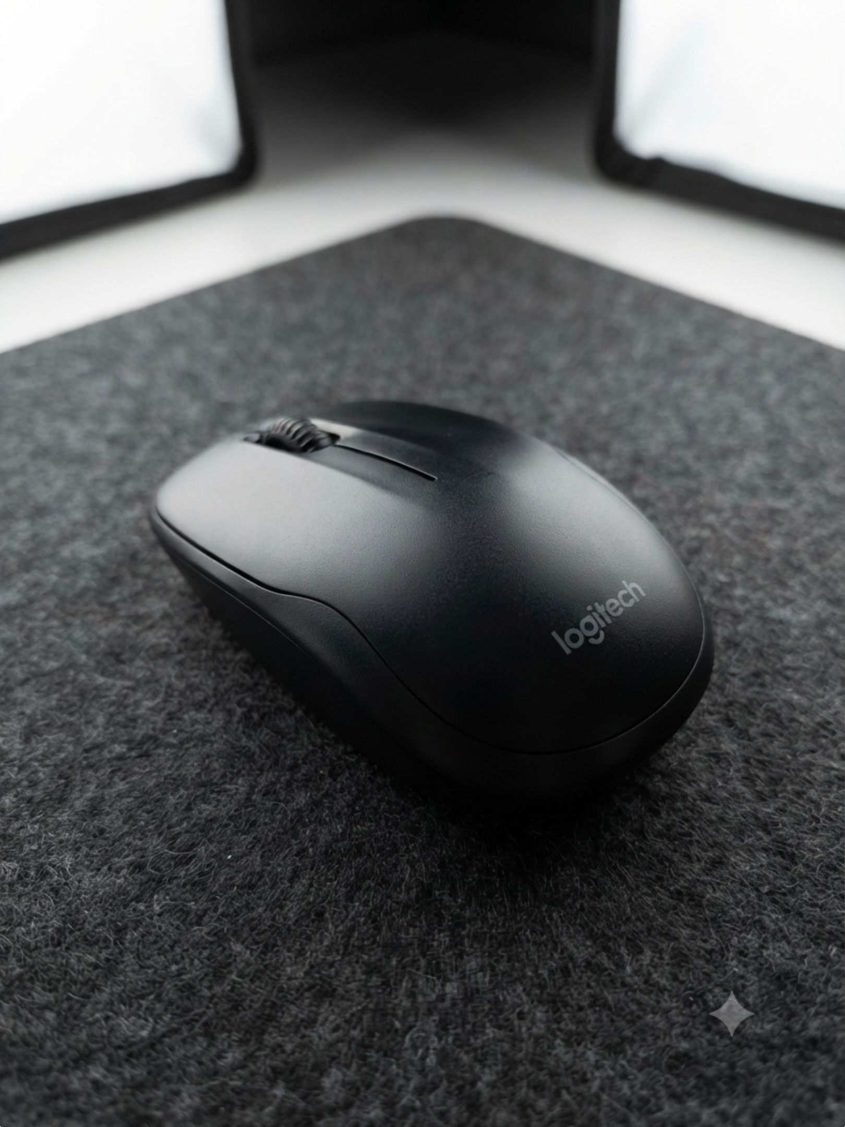
PROJECT REPORT
Teardown, Analysis, and Reverse Engineering of a Standard Computer Mouse

Slide 2
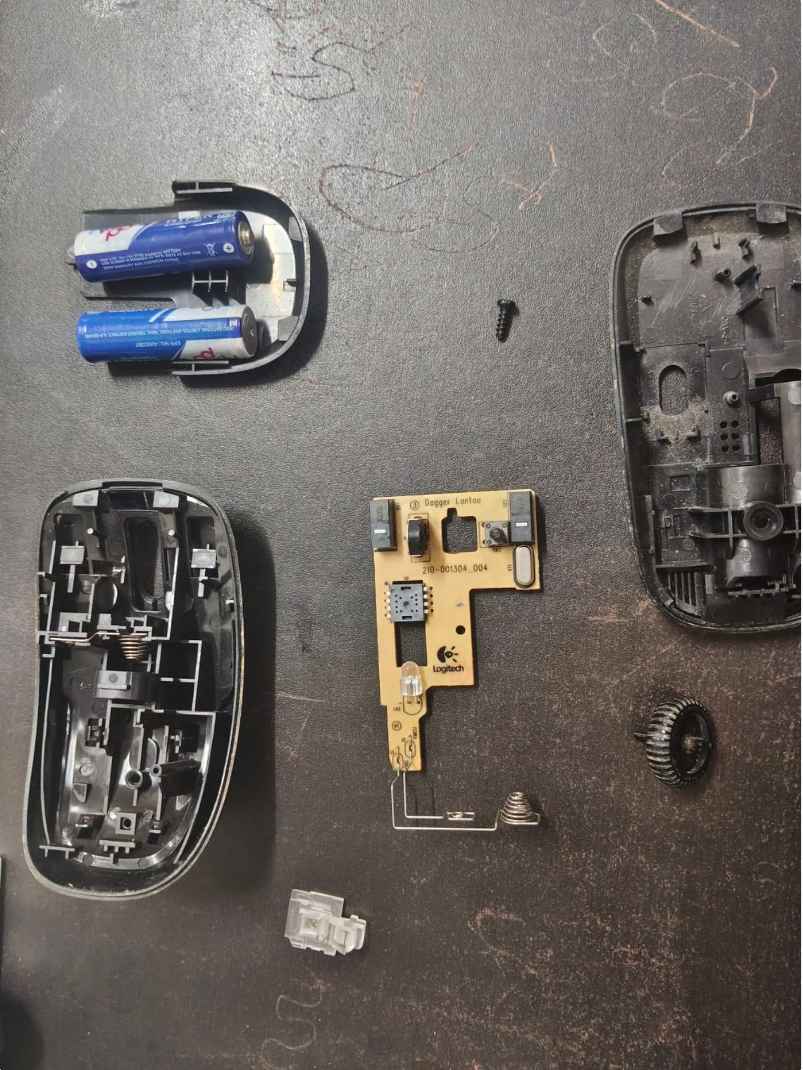
PROJECT REPORT
Executive Summary
This technical document details the structured teardown, structural analysis, and functional mapping of standard computer mouse.
The study transitions from external physical inspection and historical design evaluation to safe mechanical disassembly, component identification via datasheets, and functional system-architecture mapping.
02

Slide 3
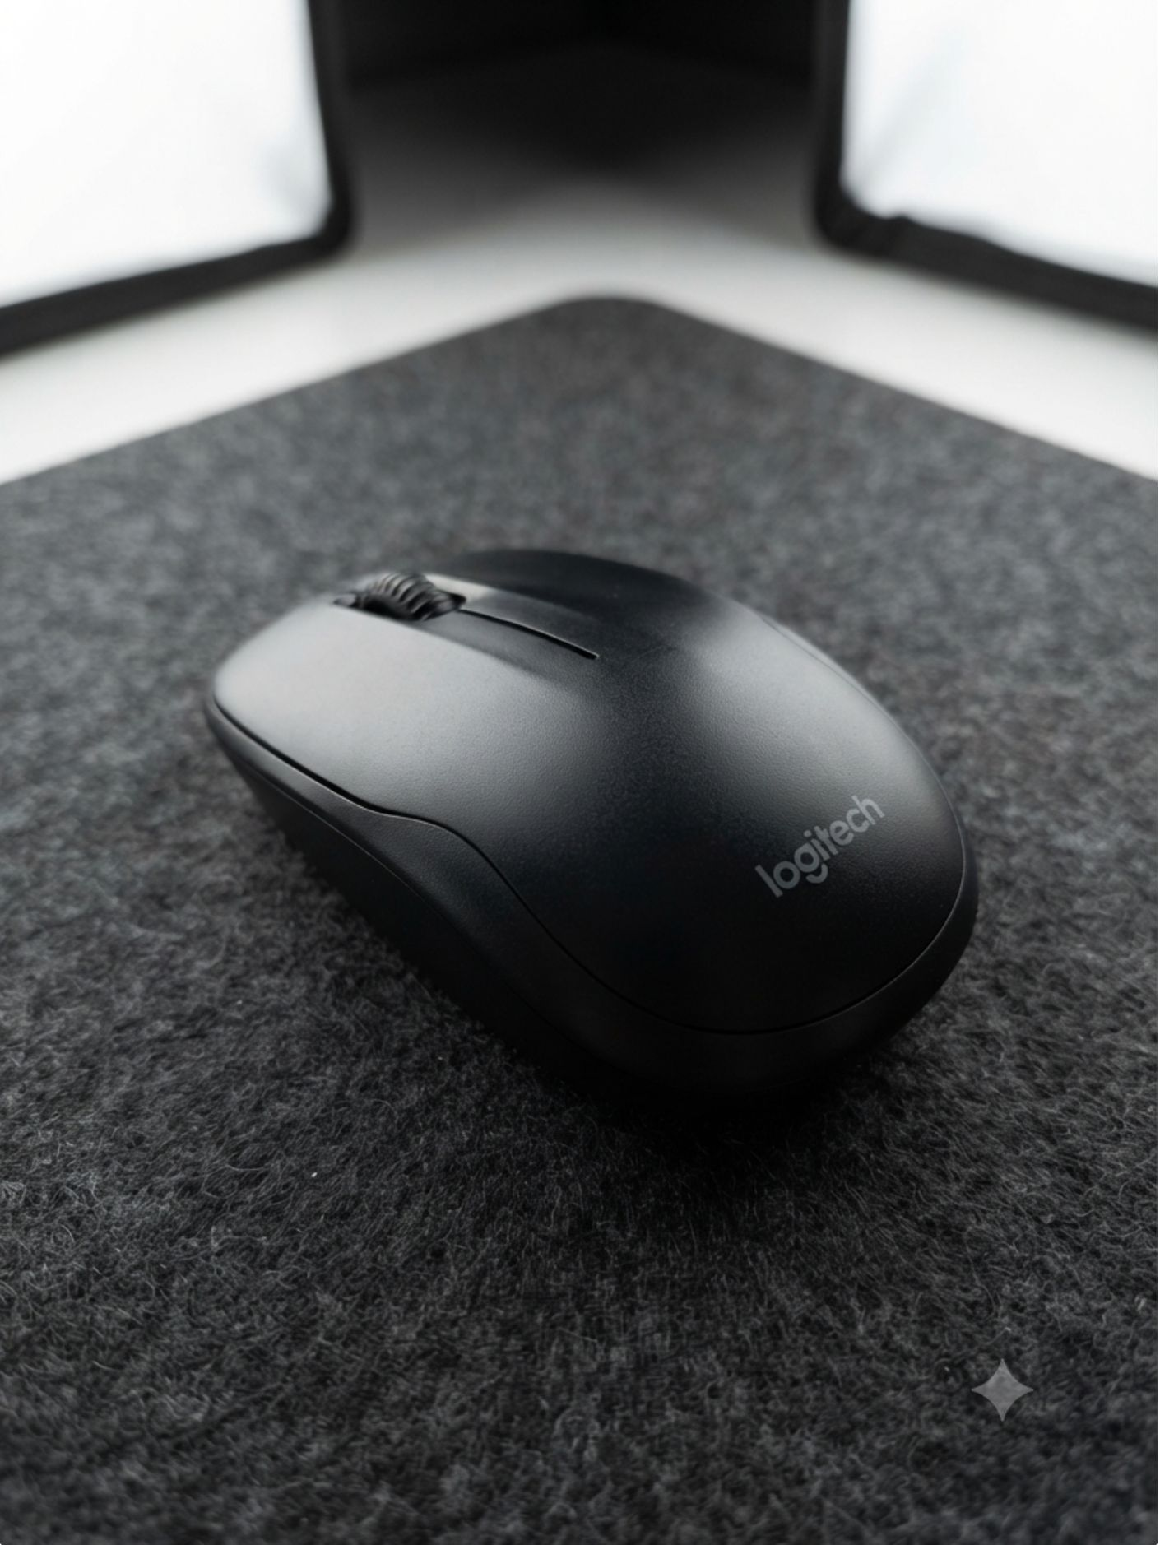
External Features
Physical Construct
Product Name/Model: Logitech Wireless Mouse (Compact Optical Mouse).
Manufacturer: Logitech.
External Dimensions: Compact profile, approximately 95 mm × 55 mm × 35 mm.
Materials & Finish: Matte-textured black polycarbonate/ABS plastic upper shell and base, with a ribbed plastic scroll wheel.
Visible Screws/Seams: Primary assembly seams run horizontally along the middle perimeter; screw access ports are typically concealed beneath sliding glide feet or product labels.
03

Slide 4
Subsystems and Modes of Operation
01
02
User Input Subsystem: Left click button, right click button, and a central mechanical scroll wheel.
Optical Tracking Subsystem: Bottom-facing optical sensor LED and lens assembly for surface tracking.
03
04
Processing & Control Subsystem: Single-chip microcontroller unit handling signal debouncing, optical data processing, and wireless packet formatting.
Wireless Communication Subsystem: RF transceiver module or integrated radio chip paired with an internal PCB antenna.
05
06
Power Subsystem: Battery compartment, spring contacts, and a manual physical power toggle switch.
Modes: Active/Tracking, Idle/Standby, Sleep, and Off.
04

Slide 5

Purpose of the Product
CORE FUNCTION
PROBLEM SOLVED
To act as an intuitive, portable human-interface device that translates physical hand movements and finger clicks into smooth, precise cursor manipulation and commands on a computer screen.
Eliminates the physical desk constraints and clutter of tethered wired mice, offering ergonomic mobility, untethered operation, and high-precision cursor control.
User Needs Addressed
Portability
Reliability
Ergonomics & Comfort
Plug-and-Play Simplicity
05

Slide 6
From Mechanical Genesis to Wireless Precision
Early Stage (1960s–1970s)
Second Generation (Late 1990s–2000s)
A bulky wooden box with perpendicular metal wheels/discs or early trackball designs.
Solid-state optical sensors, LEDs or infrared/laser diodes, and USB plug-and-play.
1
2
3
4
First Generation (1980s–1990s)
Latest Generation (Present)
Ball mouse with internal pinch rollers and optical encoder wheels.
Miniature CMOS optical sensors, power-management microcontrollers, 2.4 GHz RF nano-receivers, and Bluetooth multi-device switching.
06

Slide 7
Engineering Importance in the Evolution
RELIABILITY & MAINTENANCE
STANDARDIZATION & USABILITY
ERGONOMICS & EFFICIENCY
Removing moving mechanical parts eradicated mechanical wear-and-tear and dust accumulation.
The shift from proprietary serial connections to universal USB standards and plug-and-play wireless protocols made mice universally compatible.
Miniaturization allowed hand-contouring shells that reduce repetitive strain during long computing sessions, while low-power wireless architectures freed users from desk clutter.
07

Slide 8
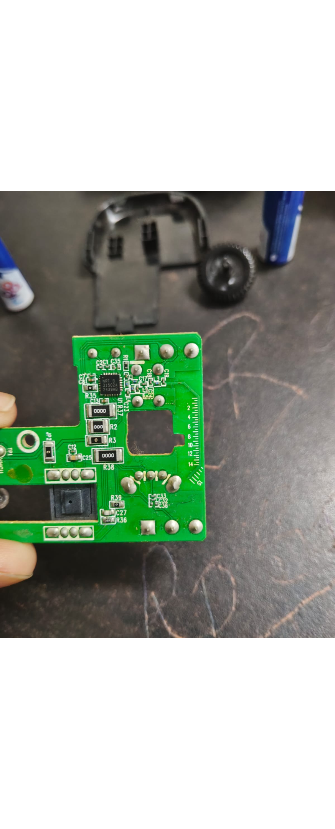
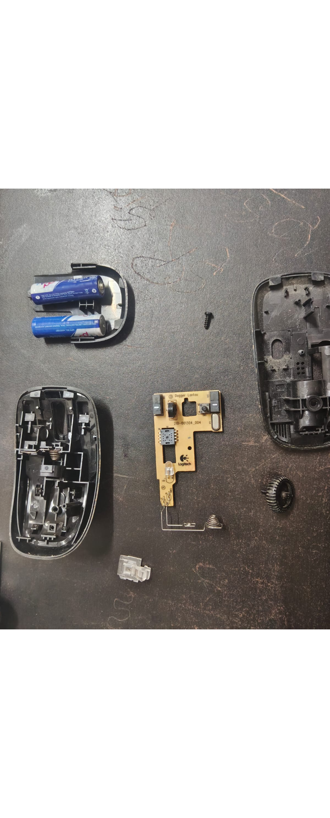
Internal Components
The product under analysis is a standard wireless optical computer mouse powered by a single consumer battery and operated via a USB nano-receiver.
It is designed to capture user physical inputs—clicks, scrolling, and X-Y translation—and translate them into high-speed radio frequency signals for host computer navigation.
08

Slide 9
Internal Block Diagram: Functional View
01
02
03
04
Power Source: 1x AA/AAA Battery.
Power Management: Voltage LDO / DC regulation.
User Input: Micro-switches.
Optical Sensor: CMOS / lens and LED illumination.
05
06
07
Microcontroller: MCU / ASIC, the central brain.
RF Transceiver: 2.4 GHz core.
USB Nano-Dongle: Host system interface.
Power and input signals converge at the microcontroller, move through the RF transceiver, and reach the host through the USB nano-dongle.
09

Slide 10
Complete Working Flow
Power Initialization: The battery supplies DC voltage, regulated by internal traces to power the active components.
01
Motion Acquisition: The LED illuminates the tracking plane while the optical sensor records surface variations.
02
Signal Processing: The MCU computes X-Y vector coordinates and checks the state of the left, right, and scroll-wheel micro-switches.
03
Wireless Transmission: Processed data packets are transmitted via the 2.4 GHz radio frequency module to the external USB receiver.
04
Host Execution: The computer’s operating system reads the incoming USB HID data and moves the on-screen cursor or executes click commands accordingly.
05
10

